Slide 1
Project Update
Topic: Bengali Handwritten Characters Recognition
- By: ”Bornomalar Bondhu”

Slide 2
Work Outline
Literature Review
Data Collection & Preprocessing

Slide 3
Literature Review
A Machine Learning Approach for Bengali Handwritten Vowel Character Recognition.
A Universal Way to Collect and Process Handwritten Data for Any Language.
BornoNet : Bangla Handwritten Characters Recognition Using Convolutional Neural Network
Ekush : A Multipurpose and Multitype Comprehensive Database for Online Off-Line Bangla Handwritten Characters
Two Decades of Bengali Handwritten Digit Recognition : A Survey

Slide 4
Data Collection
1.Ekush Comprehensive Bengali Isolated Characters Dataset.
Contains 154,824 primary Bengali Characters.
Data Source: https://rabby.dev/ekush/#external
2.BanglaLekha Isolated Dataset
Contains some 98,950 primary Bengali Characters.
Data Source: https://data.mendeley.com/datasets/hf6sf8zrkc/2
3.Data Collected by us
We will be collecting as much data as possible from individuals .

Slide 5
Data Preprocessing
1.For data collected from Ekush & BanglaLekha Isolated :
We had to remove the extra the characters other than the primary 50 characters which were present in the dataset.
Manually remove the mistakes which were there in the dataset .
Resizing the images in uniform dimension.

Slide 6
Data Preprocessing
2.For Data Collected by Us:
We prepared a form to collect the data.
Used Computer Vision techniques to read the image data ,extract the characters from the image data.
Then we applied Otsu’s method to get the threshold and convert the gray level image into binary image .
Thereafter we used Gaussian filter for smoothing and inverted the image.

Slide 7
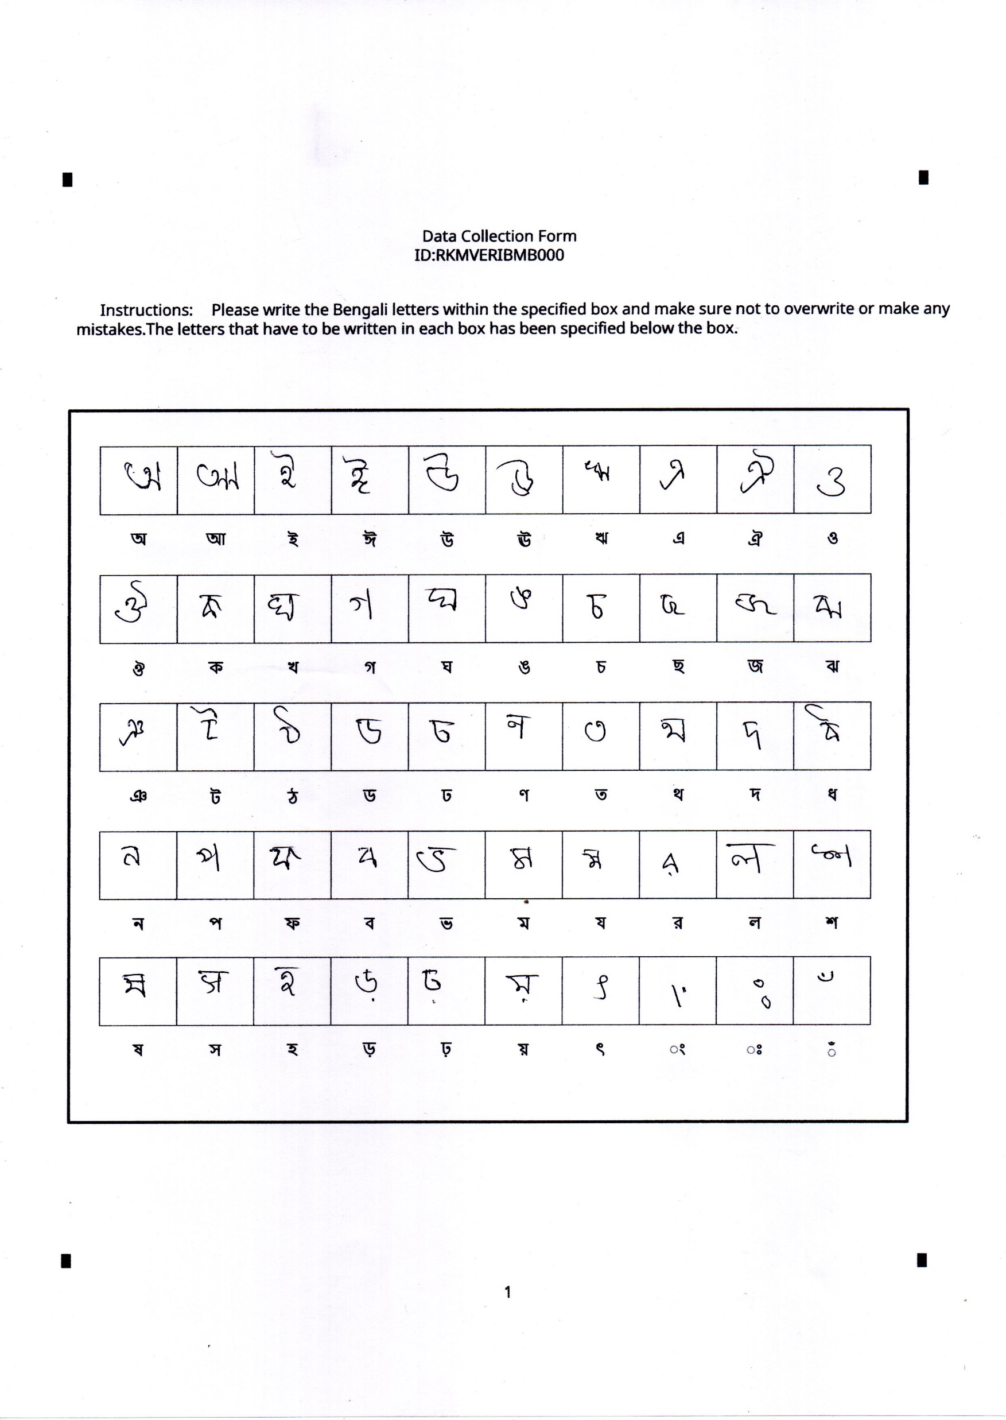
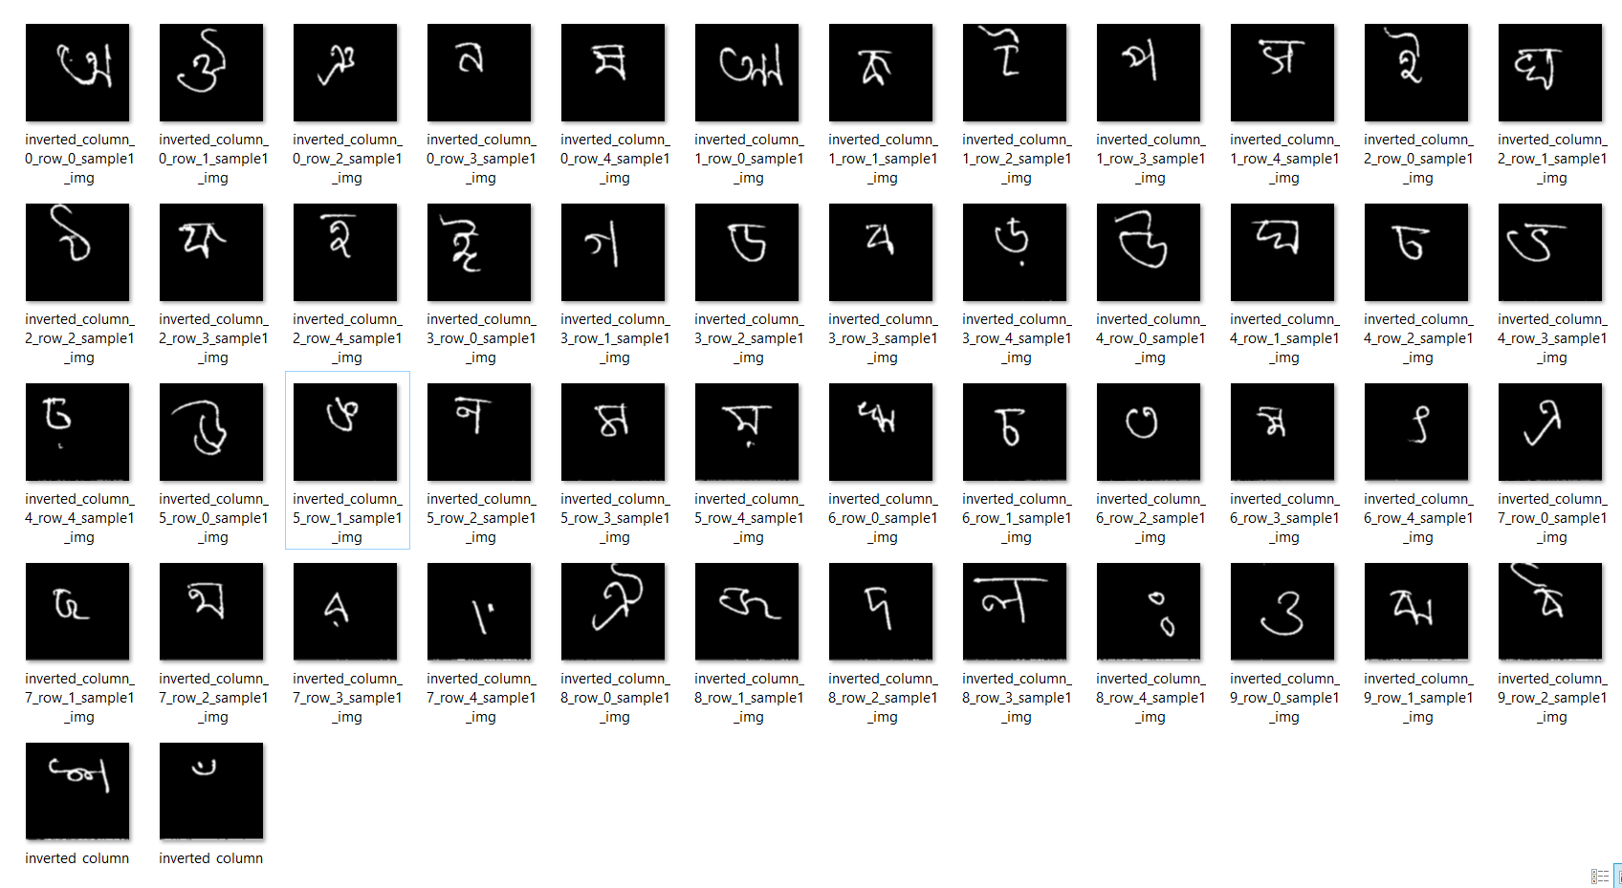
Sample Data:
After Preprocessing:

Slide 8
Thank You

